Slide 1

Construction Solutions
Expanded Polystyrene Sheet (EPS)
Panel in
Building
Construction

Slide 2



Slide 3
OUR MOTTO:
ECO Friendly
products
At Pocket
Friendly
Prices

Slide 4
EPS TECHNOLOGY
A FASTER & SIMPLER
WAY
OF
CONSTRUCTION

Slide 5

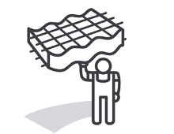



Benefits to the Builders
Inexpensive
Rapid Installation
Light Weight
Versatile
Compatible with existing system
Wide choice of Finishes

Slide 6
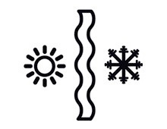






Advantages to the User
Thermal Insulation
Earthquake Resistance
Fire Resistance
Energy Efficiency
Cyclone Resistance
Load Resistance
Blast Resistance

Slide 7
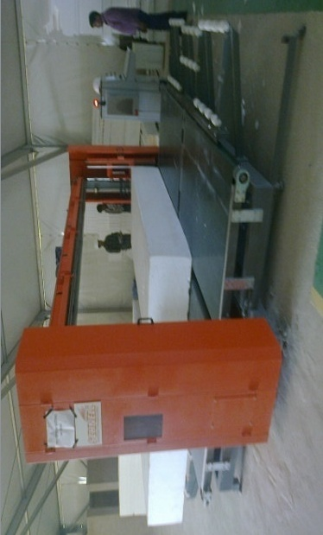
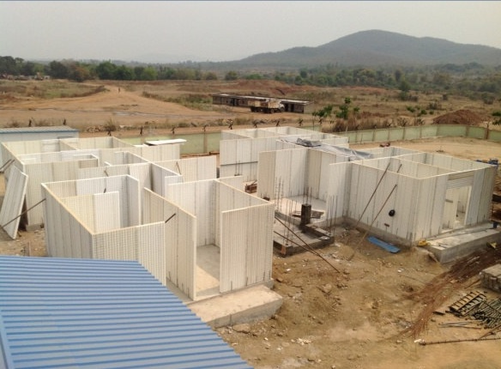
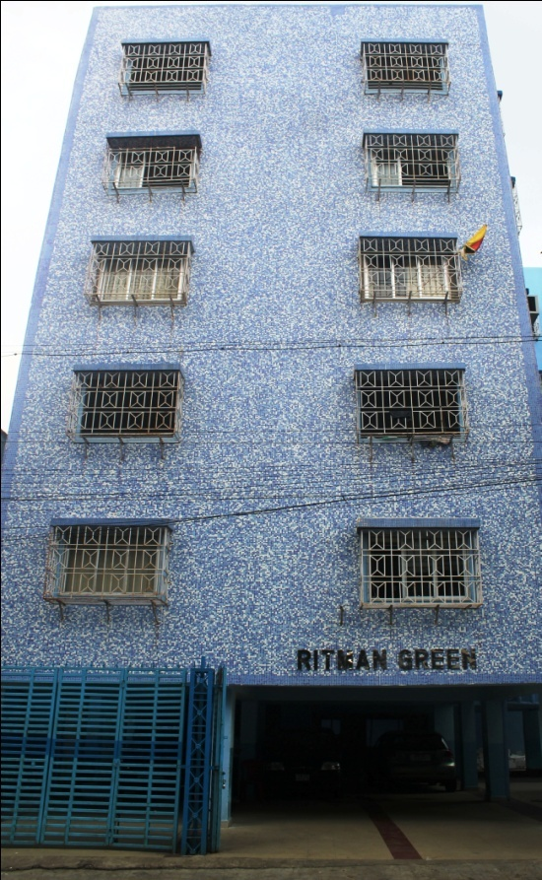
Reinforced EPS
Rapid Housing Technology

Slide 8

EPS Technology abbreviated by Expanded Polystyrene
It is a system for construction of Buildings
Using reinforced concrete load bearing walls and roof panels

Slide 9
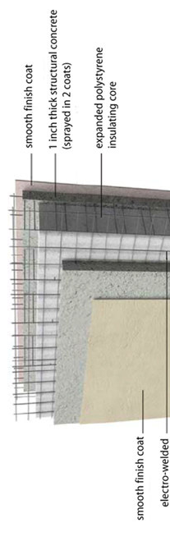
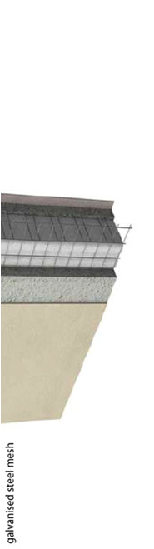

EPS System
A light weight structural system which can
Be used as load bearing walls in low-rise
Building and as partitions in high-rise RCC
and steel frame buildings.
Components of System
•Factory produced panel of undulated(wave
shape) polystyrene
•Covered on both sides by an
Interconnected electro-welded zinc coated
•The panels are assembled on site and
concreted/shotcreted in situ to realize the
Different elements of the system

Slide 10
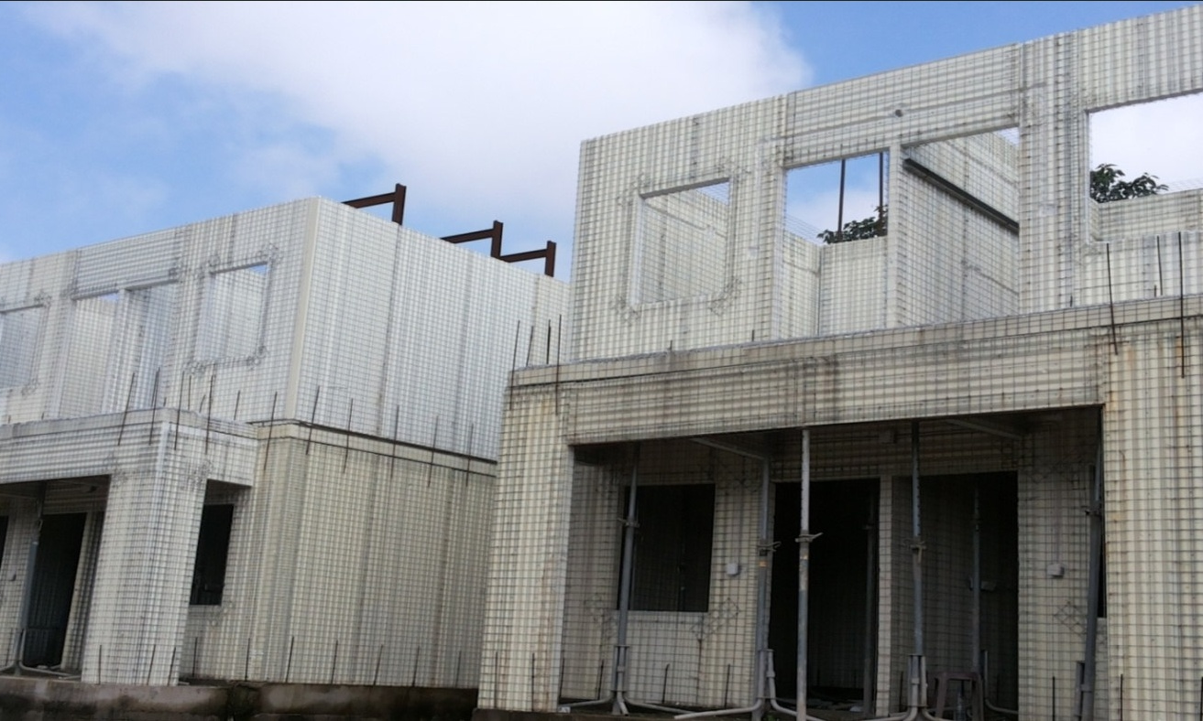
EASY AND FASTER TO INSTALL
Significant reduction in Construction period
100M2 Built
surface requires-2
days with 5 workers.
Roof concrete
pouring + shotcrete
plastering: 10 days
with 5 workers
Finishing: 10
days
Time Savings results In reduction of
Indirect Costs & Finance Cost

Slide 11
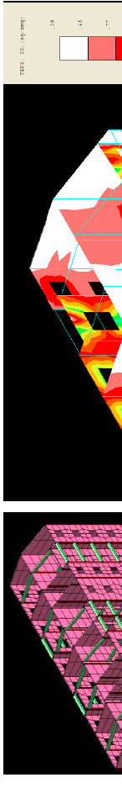
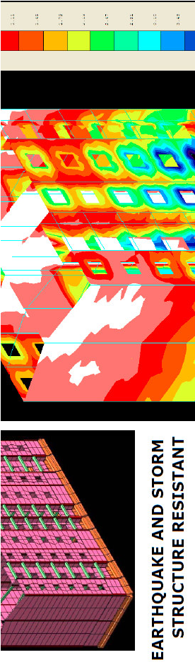
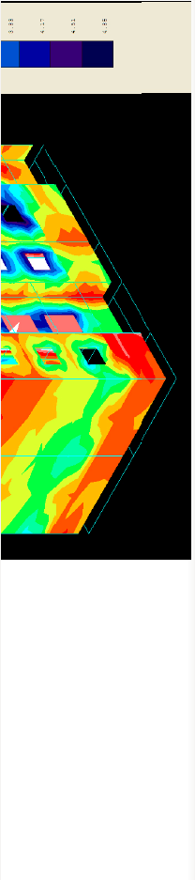
EPS Technology –Why..?
FIRE ,THERMAL AND SEISMIC RESISTANT
Could resist to
122km/h missile
and 306km/h
hurricane.
No Visible
Cracks & Damage
to Structure
when Exposed to
Seismic effect
unlike
Conventional
Brick Wall

Slide 12
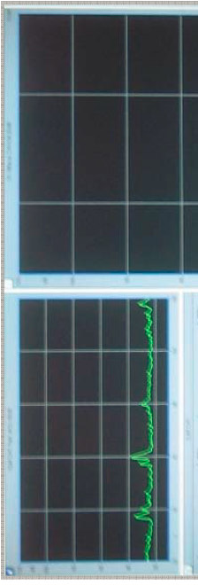
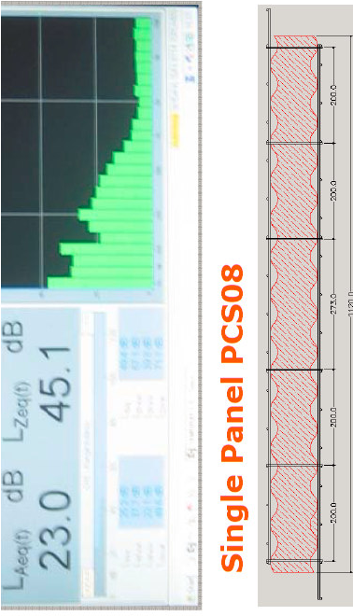
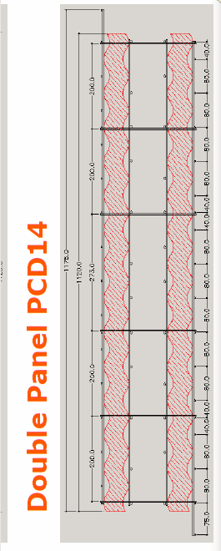
EPS Technology –Why..?
Noise Proof
Ensures Privacy
Best Acoustic Damper

Slide 13


EPS Technology –Why..?
Eco-Friendly Concept
Provides high Thermal
insulation , there by
avoiding Air conditioning
in Low cost housing.
For Air Conditioned
Housing it reduces Power
consumption.
Minimize the Usage of
Natural Resource viz.,
Clay Bricks, Stone
Aggregate etc.

Slide 14
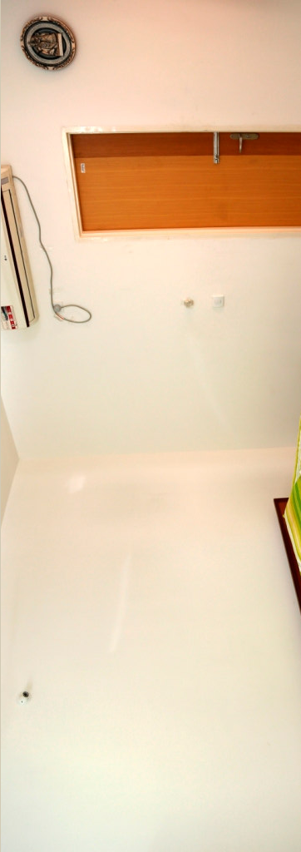
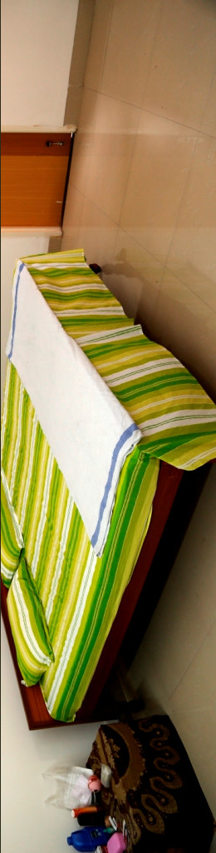
Aesthetic Look
Plain Wall
Finishes

Slide 15
Applications
Panels can be assembled on site and in situ poured concrete (double panel, floors, stairs) and shotcreted concrete (single panel) to realise the different elements of the system like,
Vertical structural walls
Horizontal structural elements
Cladding element
Internal walls

Slide 16
Construction Sequence
Preparation Base
Fix vertical anchor on the grade slab
Erect wall panel (anchoring)
Checking the alignment
Tie the weld meshes, corner mesh extra
Erect floor panels and shotcrete

Slide 17
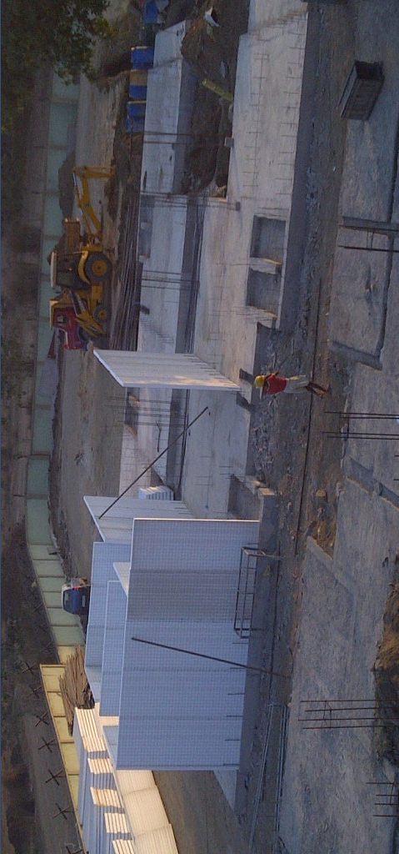
Wall Panel Erection

Slide 18
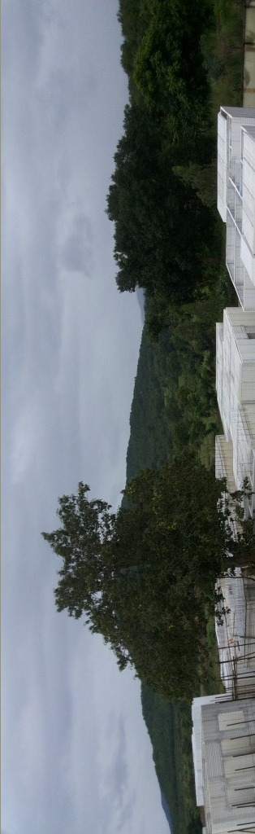
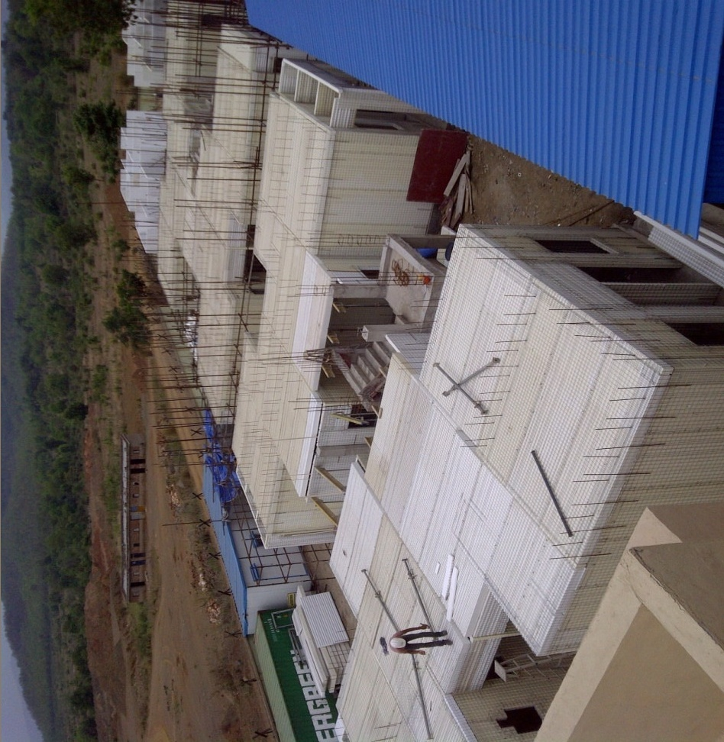
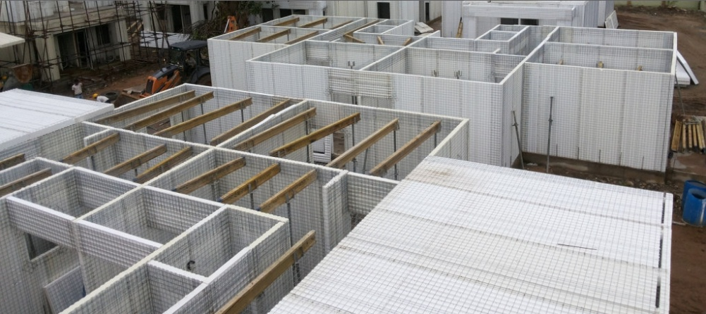
Slab Panel Erection

Slide 19
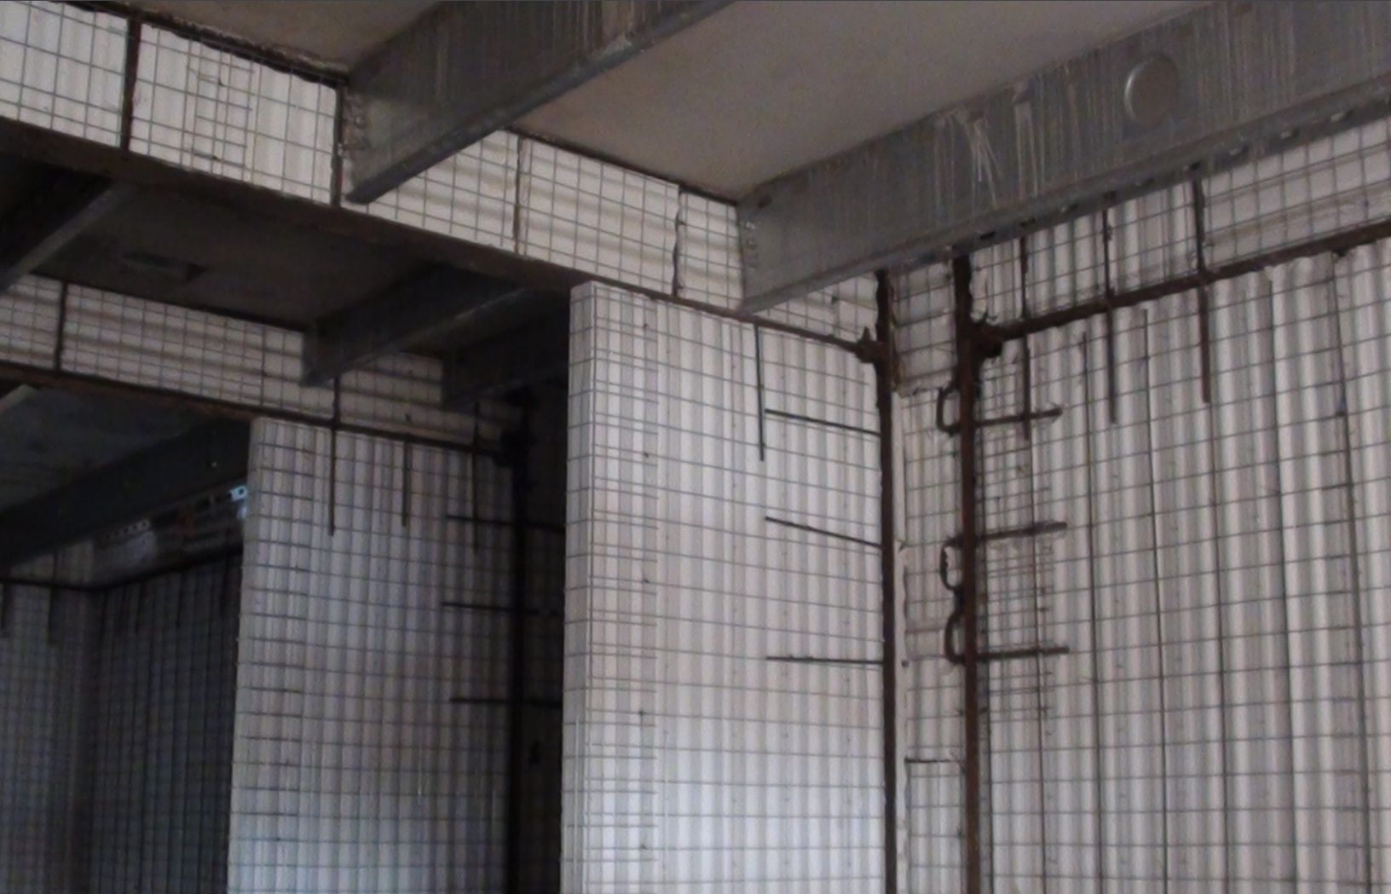
Panel & Column Junction

Slide 20
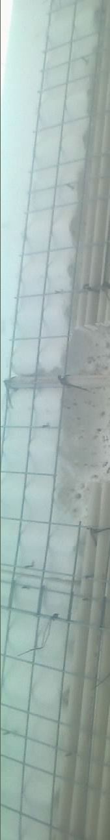
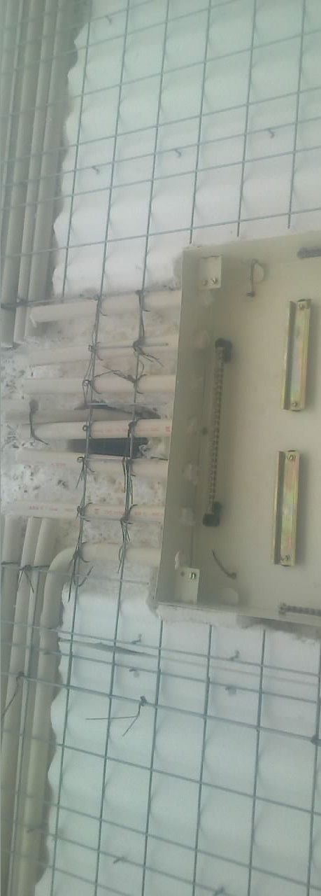
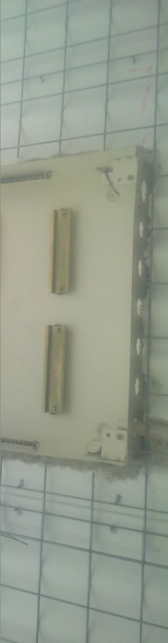
Electrical Conduiting

Slide 21
EPS Technology - - - Shotcreating involves placing a mix of 1:3
(Cement, Sand and crusher dust) cement mortar to create a structural wall.
Shotcreting is being done using pumps at pressure of 2kg/cm2
To ensure the structural behaviour of the panels, min 15mm thick shotcreting is done on panels,
To save on plastering costs, the shotcreting is done in 2 layers, the 1st layer being a rough layer and 2nd layer as a finishing layer .

Slide 22
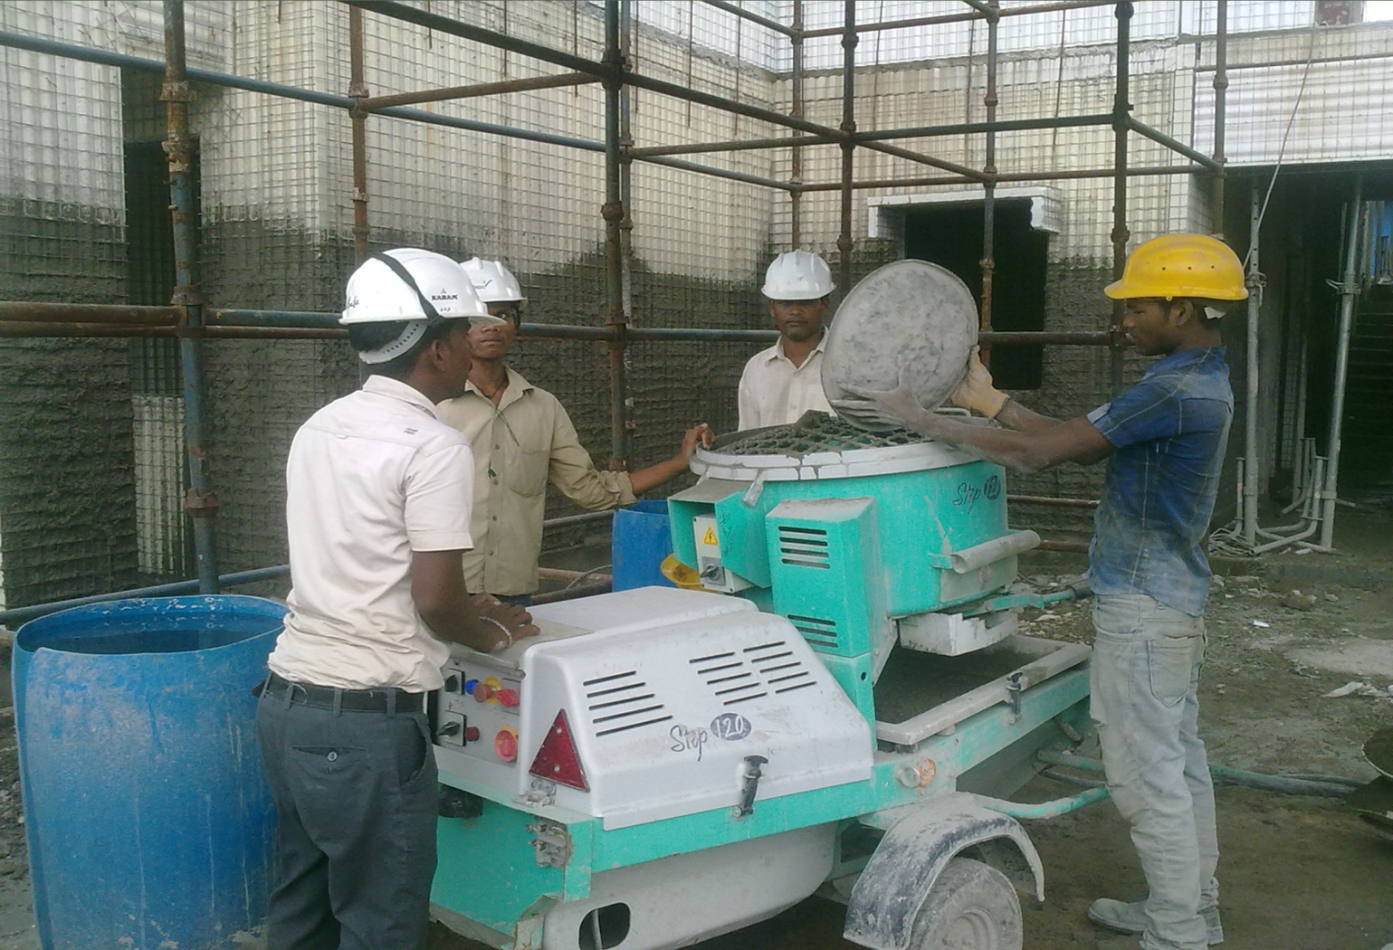
EPS Technology- shotcreting

Slide 23
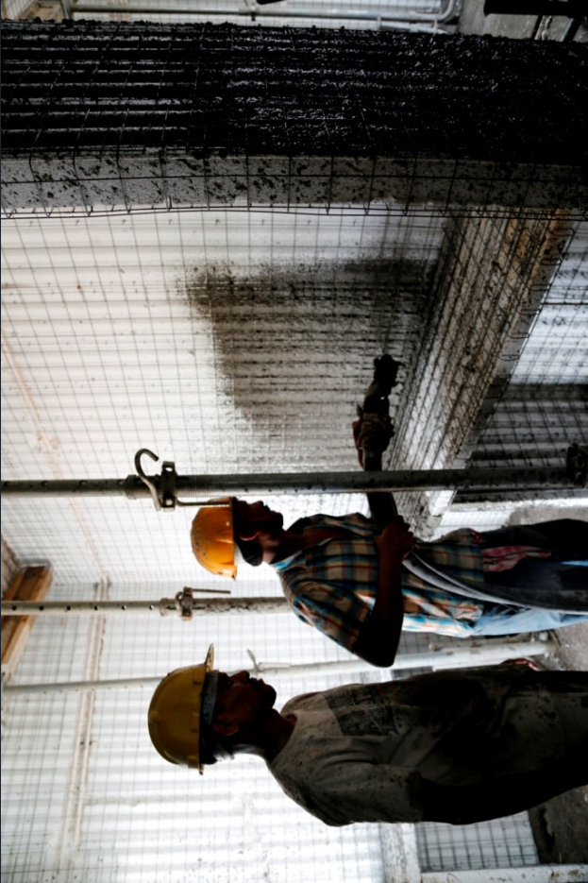
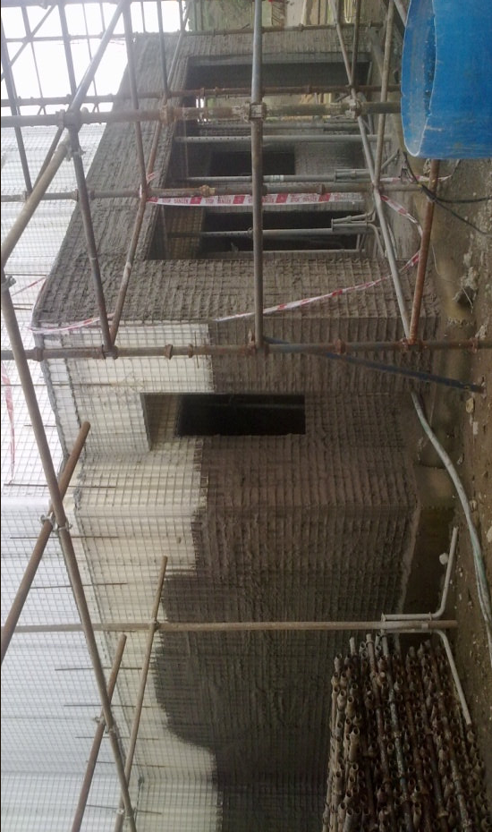

Slide 24
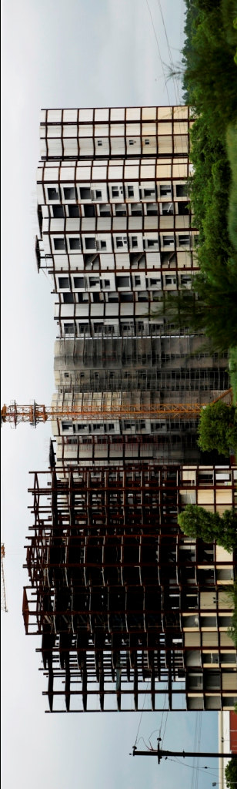
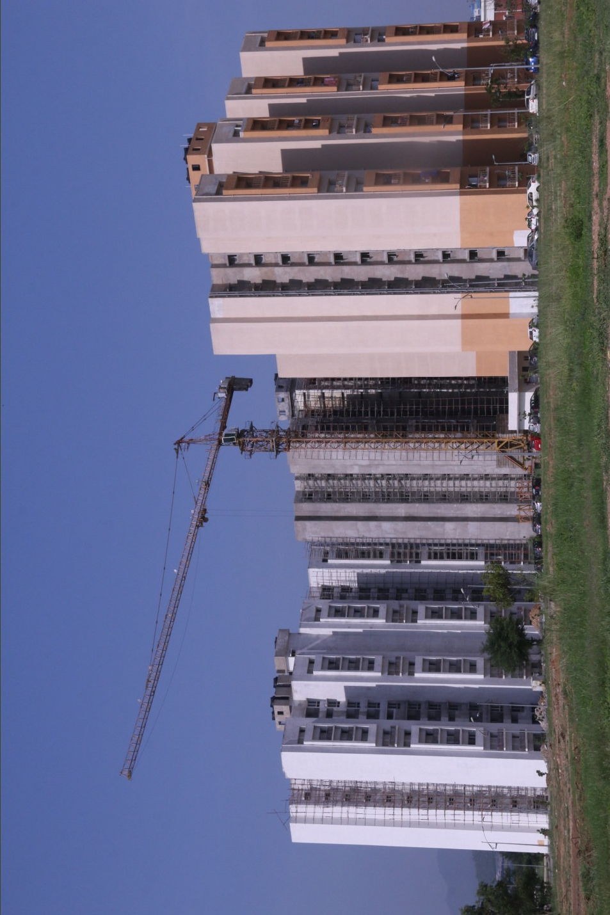
PROJECTS

Slide 25

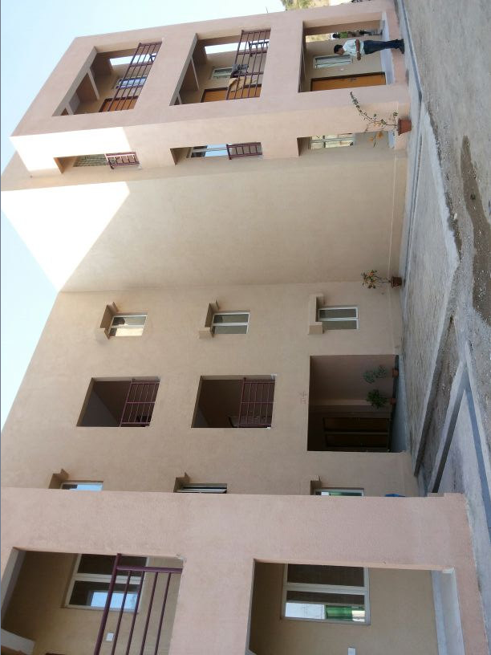
FINISHED VIEW…..

Slide 26
For any queries
Please send us an email at info@ritman.co.in
Our technical team will revert you

Slide 27
THANK YOU www.ritman.co.in
RITMAN HOUSE
14, SYED AMIR ALI AVENUE
KOLKATA 700017

